Slide 1
Defence System
Project By: UNDER GUIDANCE OF:
Parth A Punekar PROF. SHARADA H N
USN: 2SD17IS036

Slide 2
Problem Statement
We see a lot of problems in the society related to the security. Like things getting stolen from the house or from the society.
We also see unauthorized people trying to enter some restricted area.
If we scale up the problem then we can consider the international border disputes between lot of countries across the globe.

Slide 3
Idea to solve the problem
To develop such a system that detects the person from distant and keeps a watch on the person.
We can have cameras programmed such that it sees, if any person is crossing a virtually drawn line, which only camera can see and not seen by the humans.
If anyone crosses that virtual line the camera intimates it to the head office or respective place where it is programmed for.
If border disputes are considered then we can have advancement to have a gun embedded and program accordingly (i.e. either to shoot the intruder or just aim and wait for the command to shoot or reset).

Slide 4
Implementation for normal security purpose
We can use cameras (CCTV) cameras in the society and feed in the database the identity of the resident of the society, so that if any society member enters the society then the system should allow them in.
But if any stranger enters then the system stops the person and asks for the purpose of visit (verification is done by the system itself, there is no human intervention).
If the stranger wants to visit someone then the system verifies it by that person, after verification the system decides whether the person should be let in or no.

Slide 5
Implementation for advanced border level applications
At borders we cannot maintain identity of each and every soldier to implement the previous method.
But there are well defined borders, hence we can use the same border line as our reference line for the cameras.
We can determine whoever is close to the line from the opposite side then intimate it to the office.
To help cameras we can also place some sensors say ultrasonic sensors that detect distance, this can be used to check if there is something close to border, if there is anything, the sensors will intimate to the cameras as well as to the head office and also gives location.

Slide 6
Implementation for advanced border level applications
The location is used by the guns to aim the intruder. The guns are equipped with lasers and cameras to ensure the gun has aimed the intruder, since the intruder may keep moving, hence it is necessary that in all conditions the guns should aim the person.
If the gun is programmed to shoot, then it will shoot the person and intimate the same to the head office, else if it is programmed only to aim, then the gun does the same and waits for the command (i.e. shoot or release).
To help out soldiers we can also a portable screen that fit on their arm and guides them towards the intruder using the location given by the sensors.

Slide 7
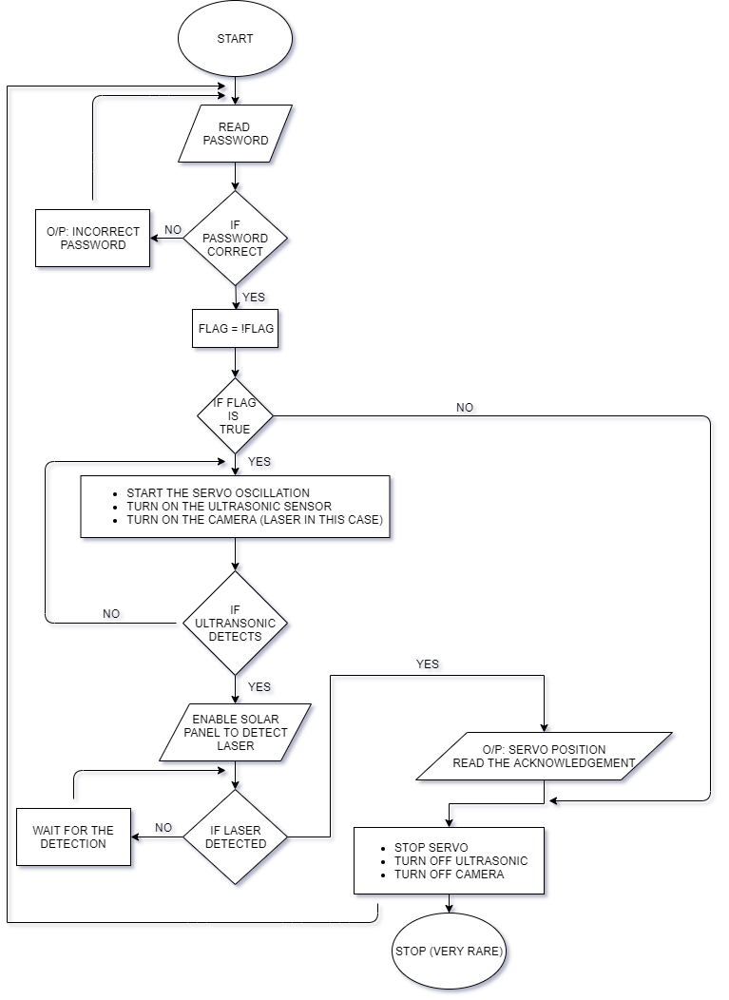
Flow chart of the system

Slide 8
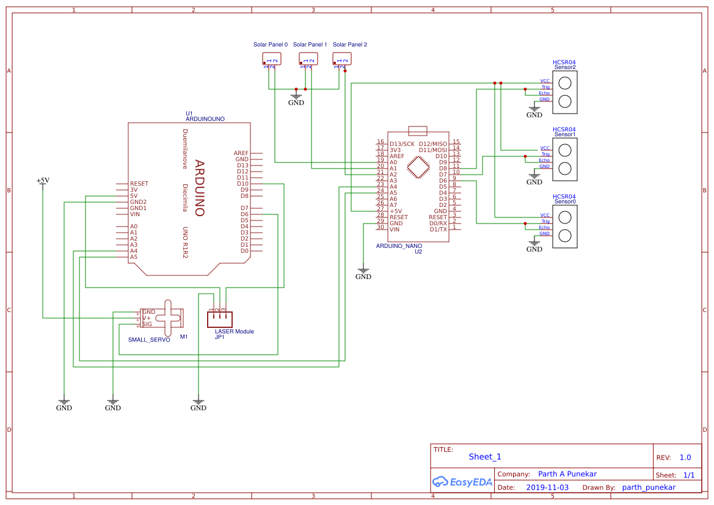
Schematic of the proposed system

Slide 9
Applications
At very domestic level this system can be used in homes, society, any firm, colleges, offices etc.
By some advancements we can use this system in securing the restricted areas like VIP homes, parliament, government offices, military areas etc.
By using high and advanced technology we can use this system to improve the security level at the international borders to a certain extent.

Slide 10
Advantages
Improved security at homes
Improved security at restricted areas
Improved security at international borders
(More advantages can be found once tested on actual grounds)

Slide 11
Disadvantages
Becomes expensive when considered for more complex systems
Might be difficult to work in most harsh climatic conditions (Eg. Siachen).
Might not yield promising results in most difficult military terrains like mountains, forests (can be confirmed by actually testing on the ground).
(More disadvantages may be found after actual tests, if any).

Slide 12


